Slide 1

MODELLING PHYSICAL SYSTEMS
Programming Simulations

Slide 2

OUTLINE
Today's topics:
VR (shortly)
Aerodynamics of biological motion
Group work and exercises
Deliveries

Slide 3
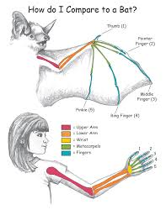
BATS – WHY BAT?
Flying mammals
Hand-wing
Morphologically different
body from a human body
(embodiment in VR), but anatomically similar
Biomimicry

Slide 4

VR – WHAT IS IT ?
VR - Ultimate communication medium simulated with help of
computer generated images and
visited with VR hardware (Biocca)
Presence - a sense of "being there" (mental concept as a reaction to technological immersion), always consider laws of physics.
Immersion - how much the user is immersed in the virtual world (physical presence)
Action → Reaction

Slide 5
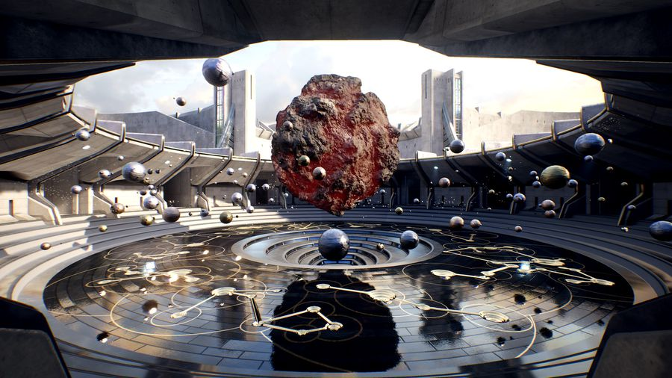
WHAT TO CONSIDER (VR APP)
Real-Time Programming (sensory technology based on human perception):
- Visual input (binocular vision & cues)
- Audio (binaural cues)
- Proprioception (movement of the body & gestural inputs)
- Touch (haptics)
- Vestibular sense (through vision or audio input)
- Taste & Smell (way out of our
league atm!)
Interaction (impact with the
environment and feedback)
Digital Narrative principals
(purpose to the VR users)

Slide 6

HISTORY of Flight
Greek Legend About Icarus

Slide 7
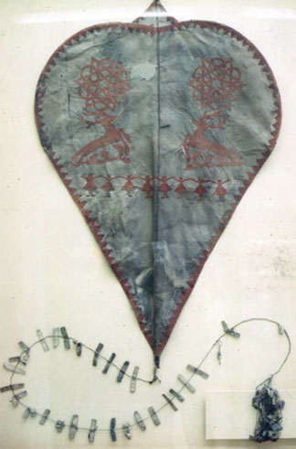
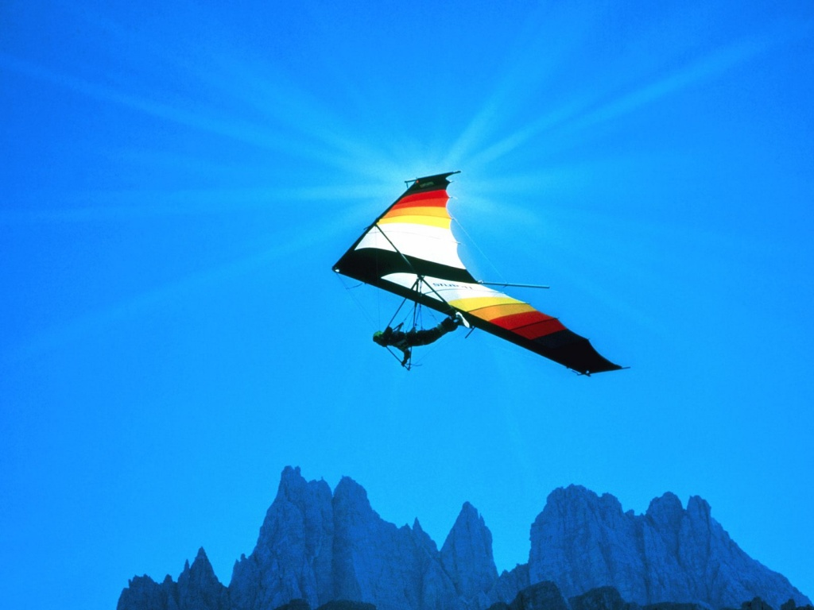
HISTORY of Flight
The first kite - China around 5th century B.C. by Mozi and Lu Ban

Slide 8
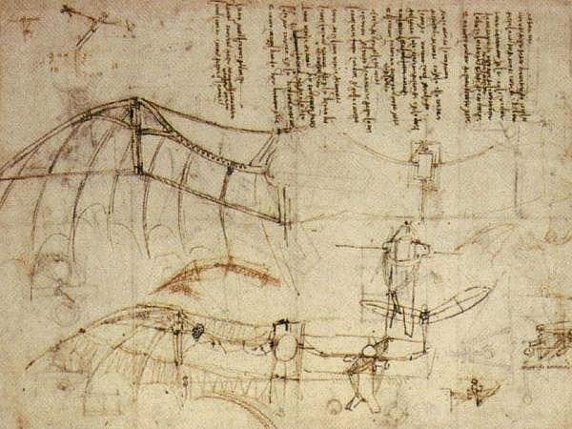
HISTORY - Scientific Background for Physics of Flight
During the renaissance period Leonardo da Vinci studied aerodynamics principles through birds
flight, though his works were unknown for almost 300 centuries.

Slide 9
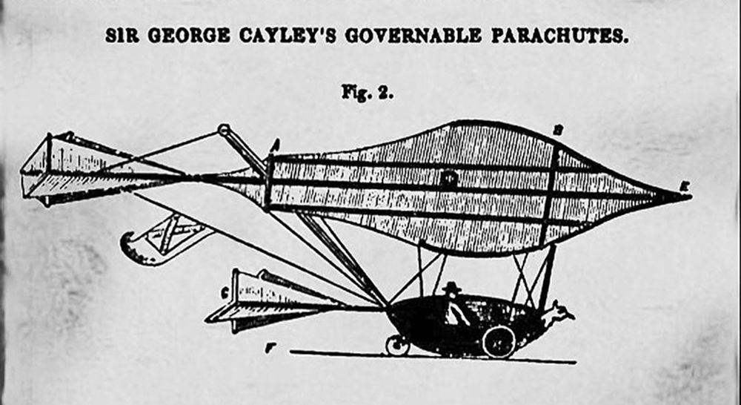
HISTORY - Scientific Background for Physics of Flight
Fundamental concepts of aerodynamics were first presented in the 18th century

Slide 10
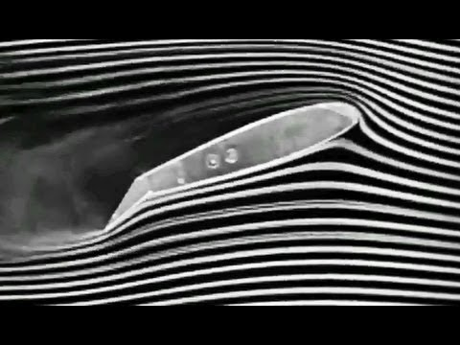
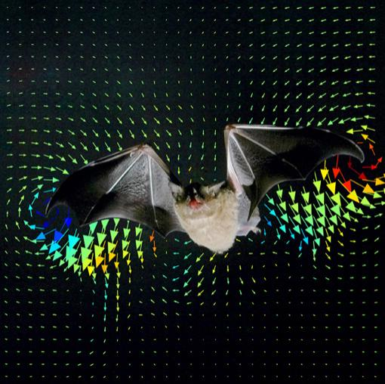
HISTORY - Scientific Background for Physics of Flight
Mathematical analysis , Wind tunnel experimentations , Computer simulations

Slide 11
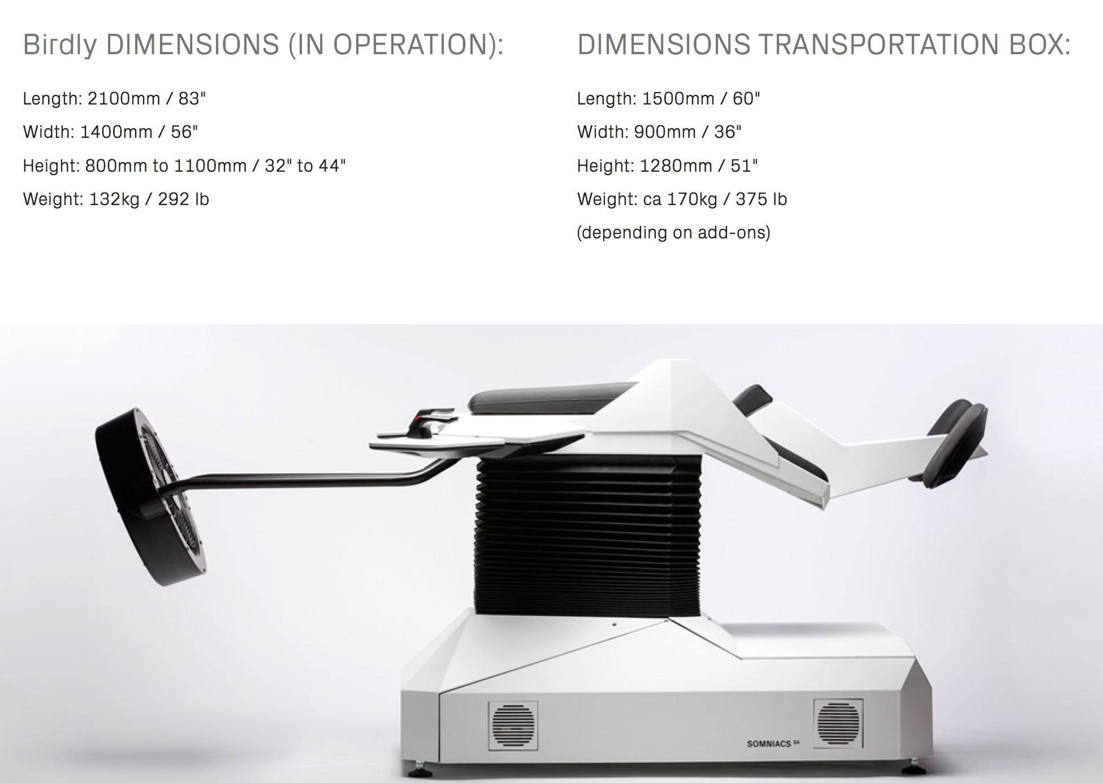
VR – ”BIRDLY”
Simulation experience of a bird-like flight
Somniacs together with Zurich University of Art and Design
a flying simulator “Birdly” https://www.youtube.com/watch?v=iYPJLRVrC18

Slide 12
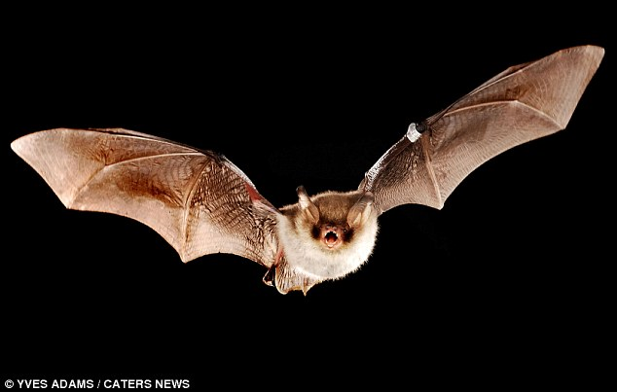
BATS – flight shortly
Their flying cycle consists of upstroke and downstroke
The main goal of flight is to minimize physical forces of Gravity during the upstroke and maximize
air-displacement during the downstroke.
Bats do have both day- and nighttime visions (black and white gamma).
Details of objects are missing in their visual system.
Their size and the wingspan influence the flying gait – bigger bats fly faster than the smaller ones
They use echolocation for orientation

Slide 13
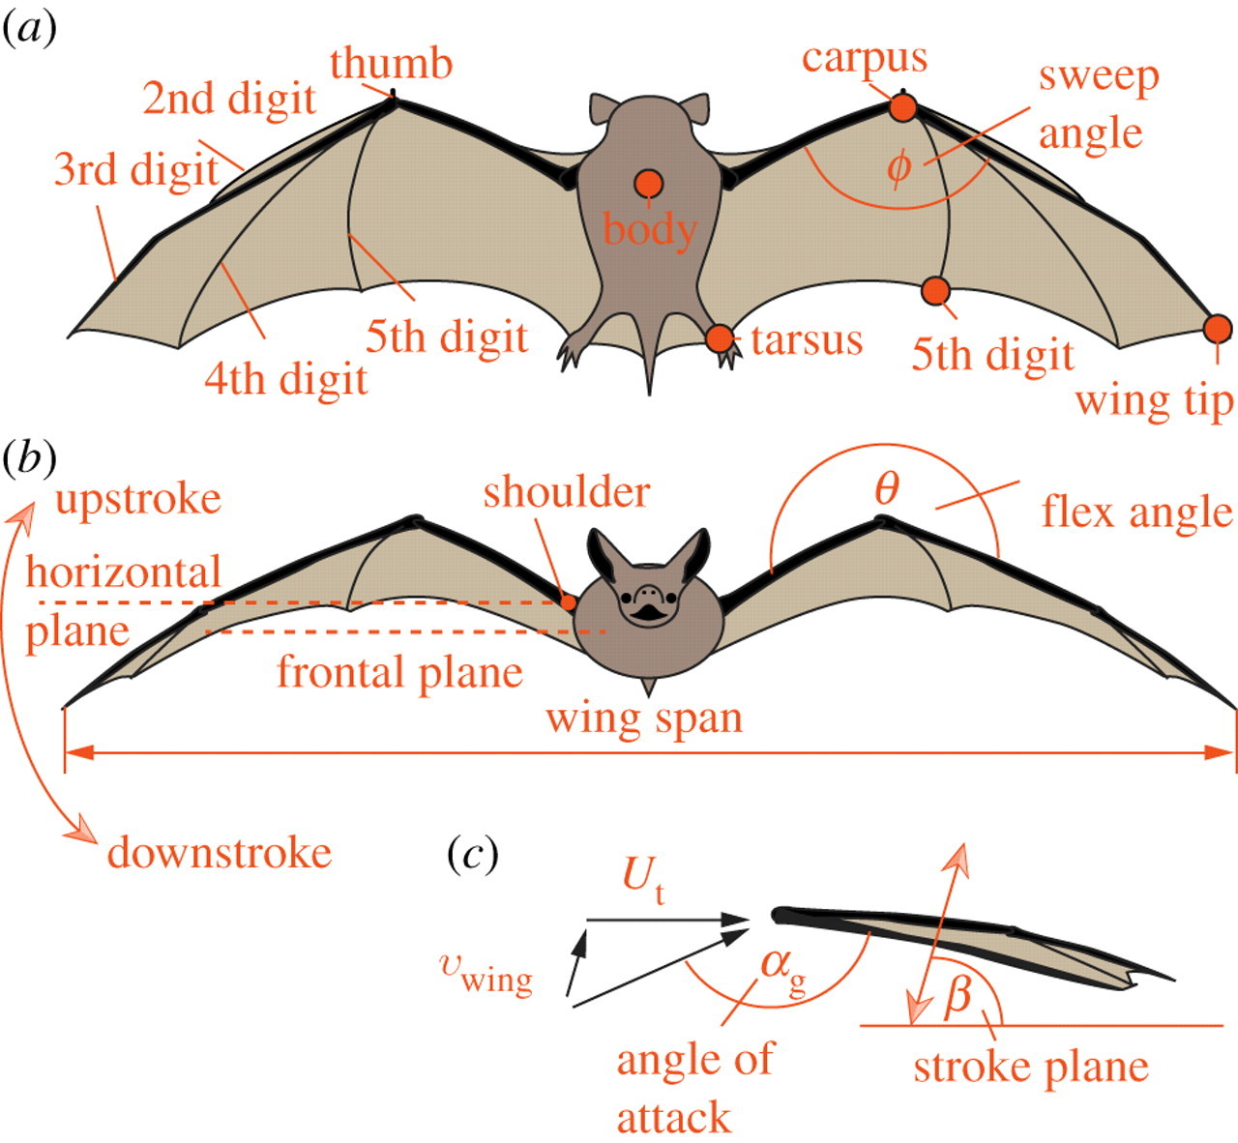
BATS – flight shortly

Slide 14
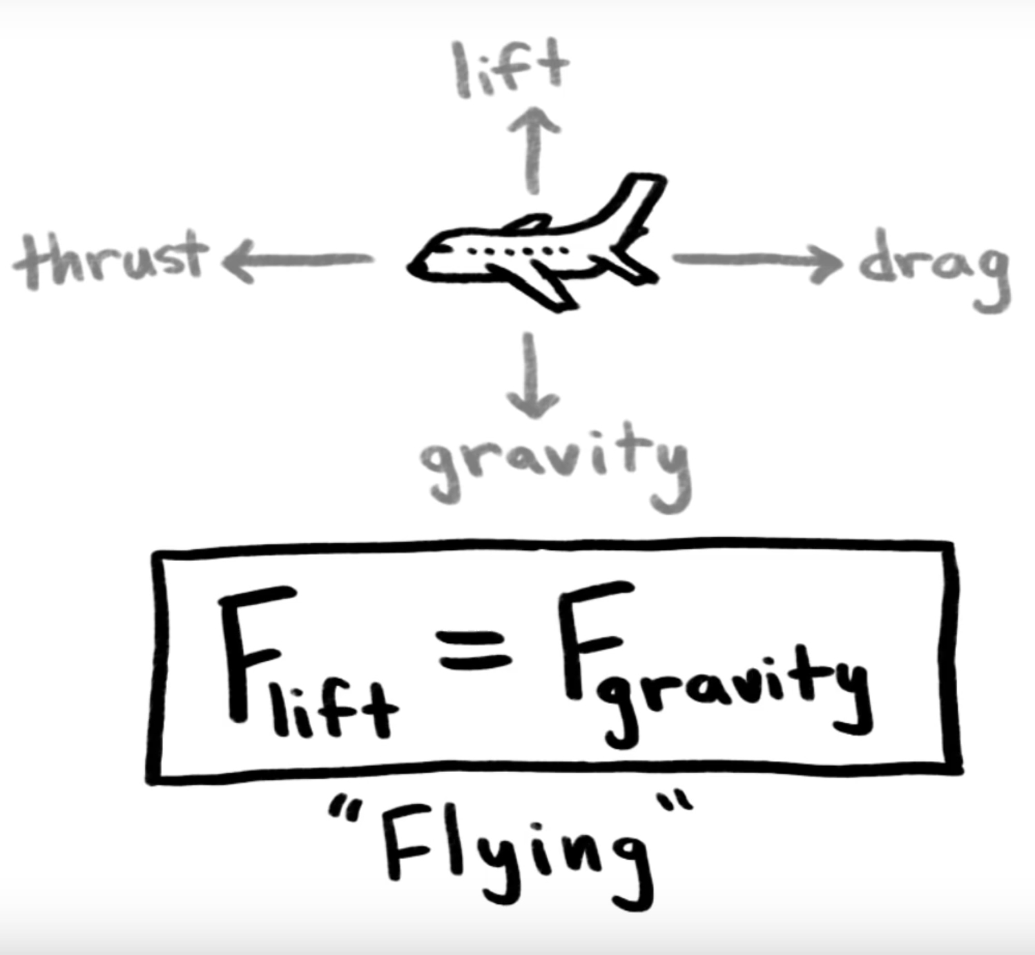
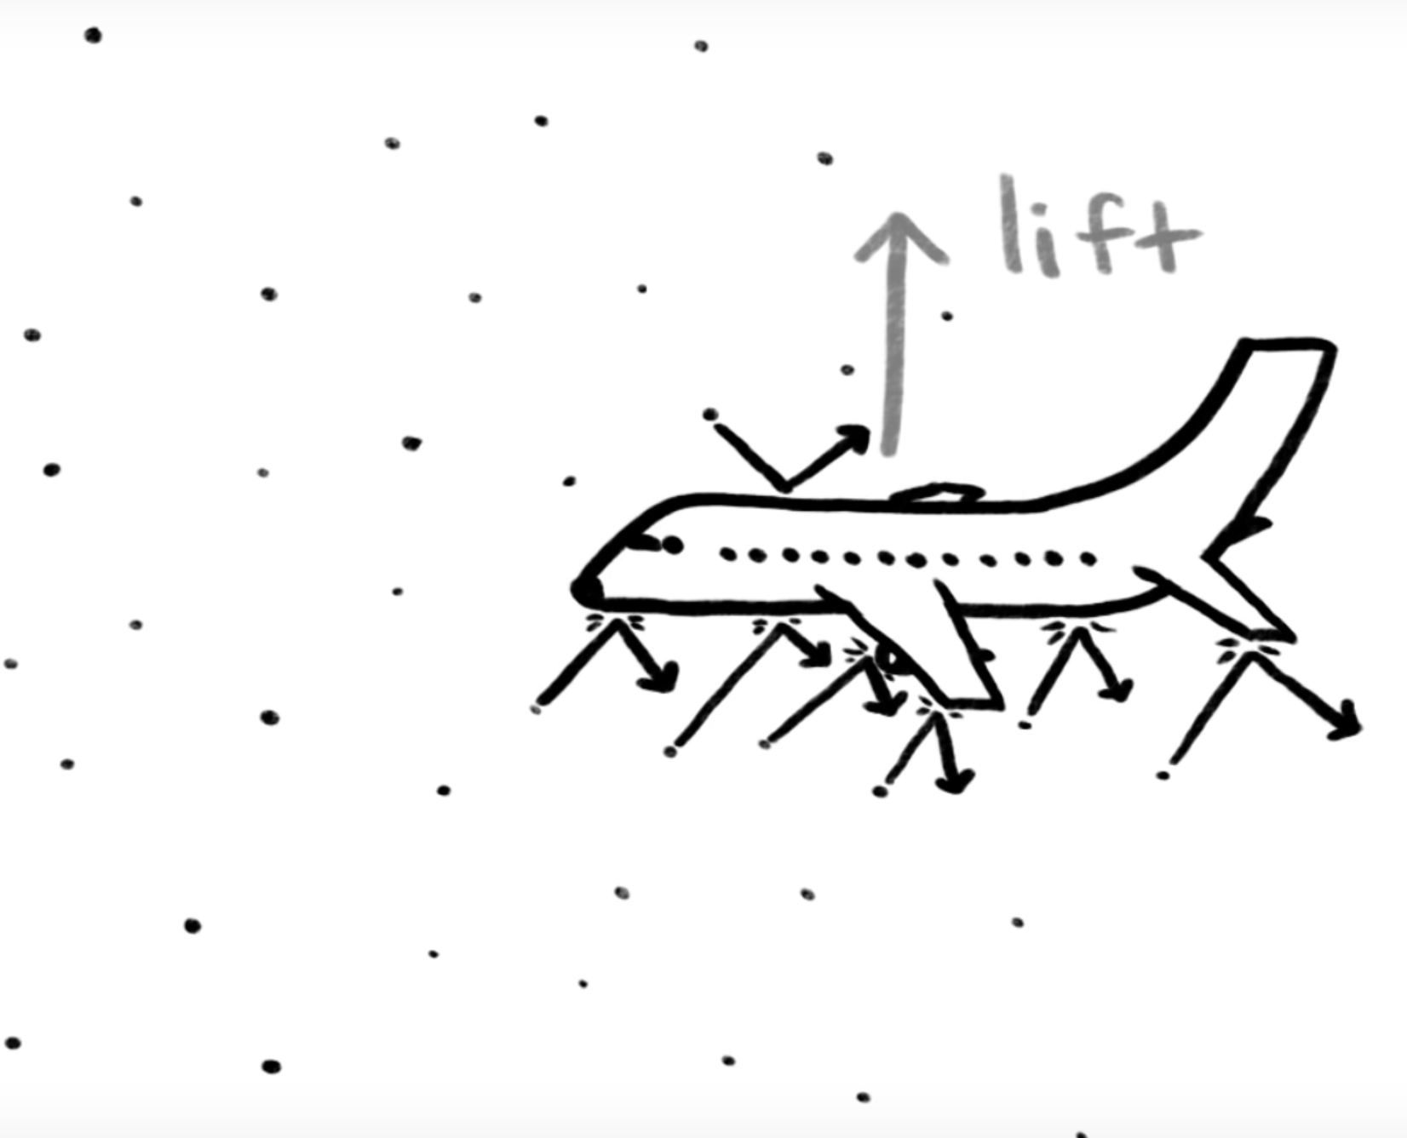
AERODYNAMICS
Forces influencing the flying body in the air
First Law of Motion !
Planes stay in the air as there´s no Netto-Force influencing them
→ if there´s no Netto-Force the object at rest stays at rest and
an object at motion stays that way
Having air molecules pushing the plain up is the
crucial part of flying
Air speed over the top wing has to be faster than below wing → air pressure
on top will be lower than at the bottom

Slide 15
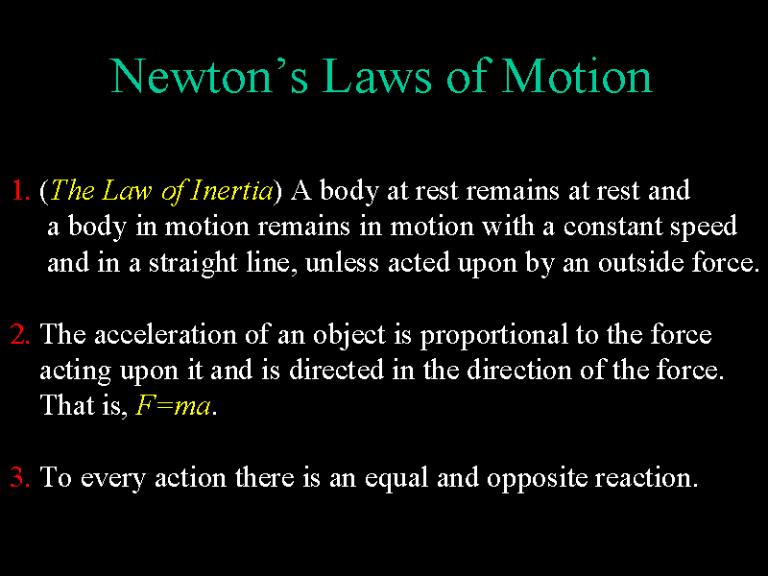
AERODYNAMICS
Newton´s 2nd and 3d laws of motion explain the basic principals of aerodynamics

Slide 16
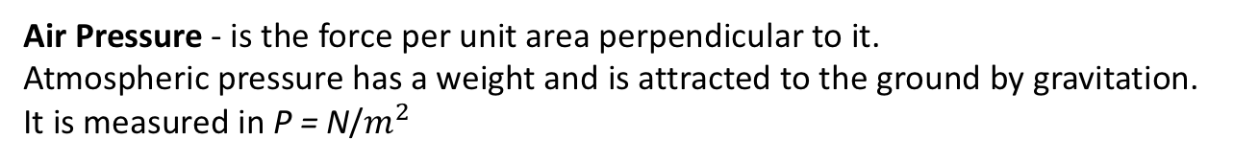
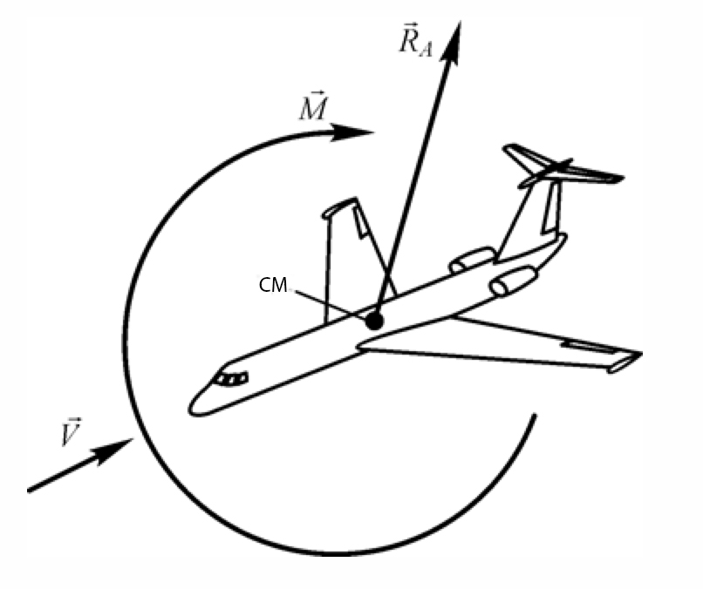
AERODYNAMICS
Air Pressure - is the force per unit area perpendicular to it.
Atmospheric pressure has a weight and is attracted to the ground by gravitation.
It is measured in P = N/
Air Density – is the ammount of air contained in the volume of 1. It is decided that at the
standard atmospheric conditions 1 = 1.225 (air weight), but density = 0.1250
The mechanical effect of the upcoming airflow is distributed over the surface of the body.
Aerodynamic force and Moment are applied to the Center of Mass (COM) of the flying body,
All the forces and Moments are vector units, since they represent
changes of the position of the body in space under the applied forces.
Momentum is applied as soon as the body changes its position in the
space.

Slide 17

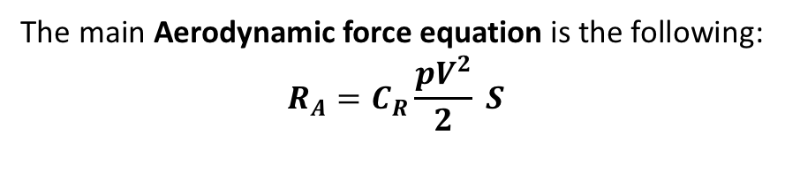
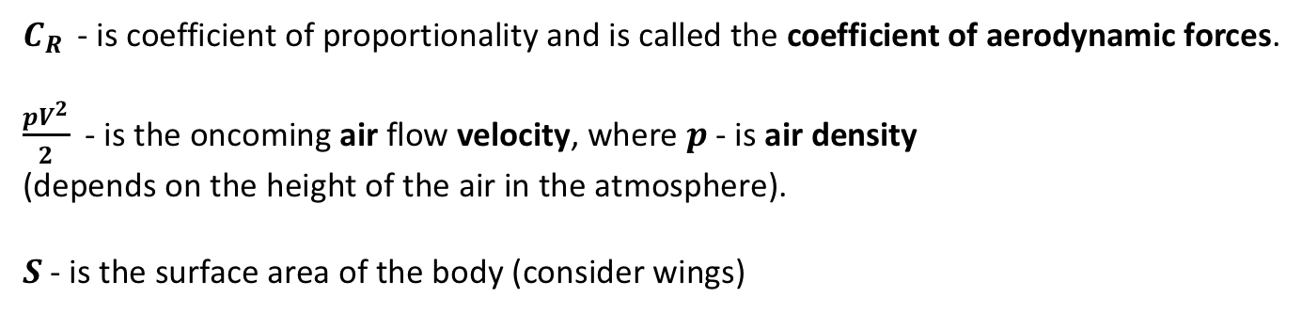
AERODYNAMICS
The main Aerodynamic force equation is the following:
- is coefficient of proportionality and is called the coefficient of aerodynamic forces.
- is the oncoming air flow velocity, where - is air density
(depends on the height of the air in the atmosphere).
- is the surface area of the body (consider wings)
The larger the object/e.g.bat is, the faster it flies (in order to generate lift required to fly )
Since wings generate lift due to the flow of air over the wing surface, larger wings with low
wingload (the total weight of an aircraft divided by the area of its wing) would have more lift at
any given speed.

Slide 18
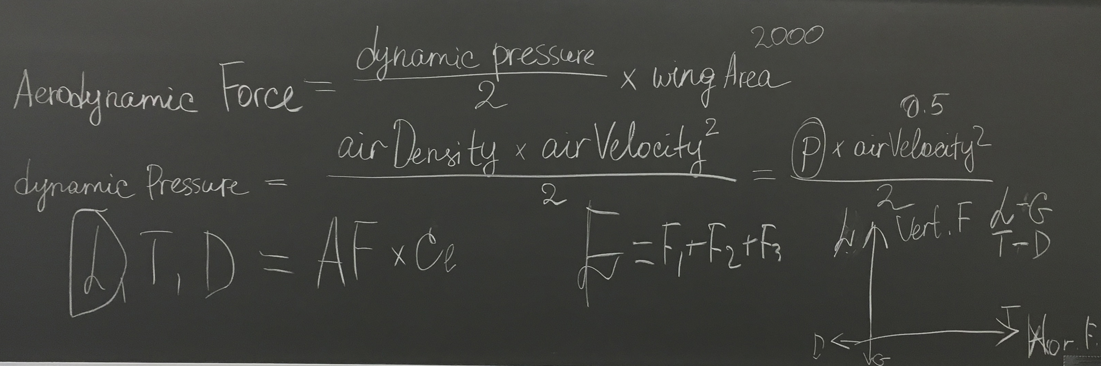
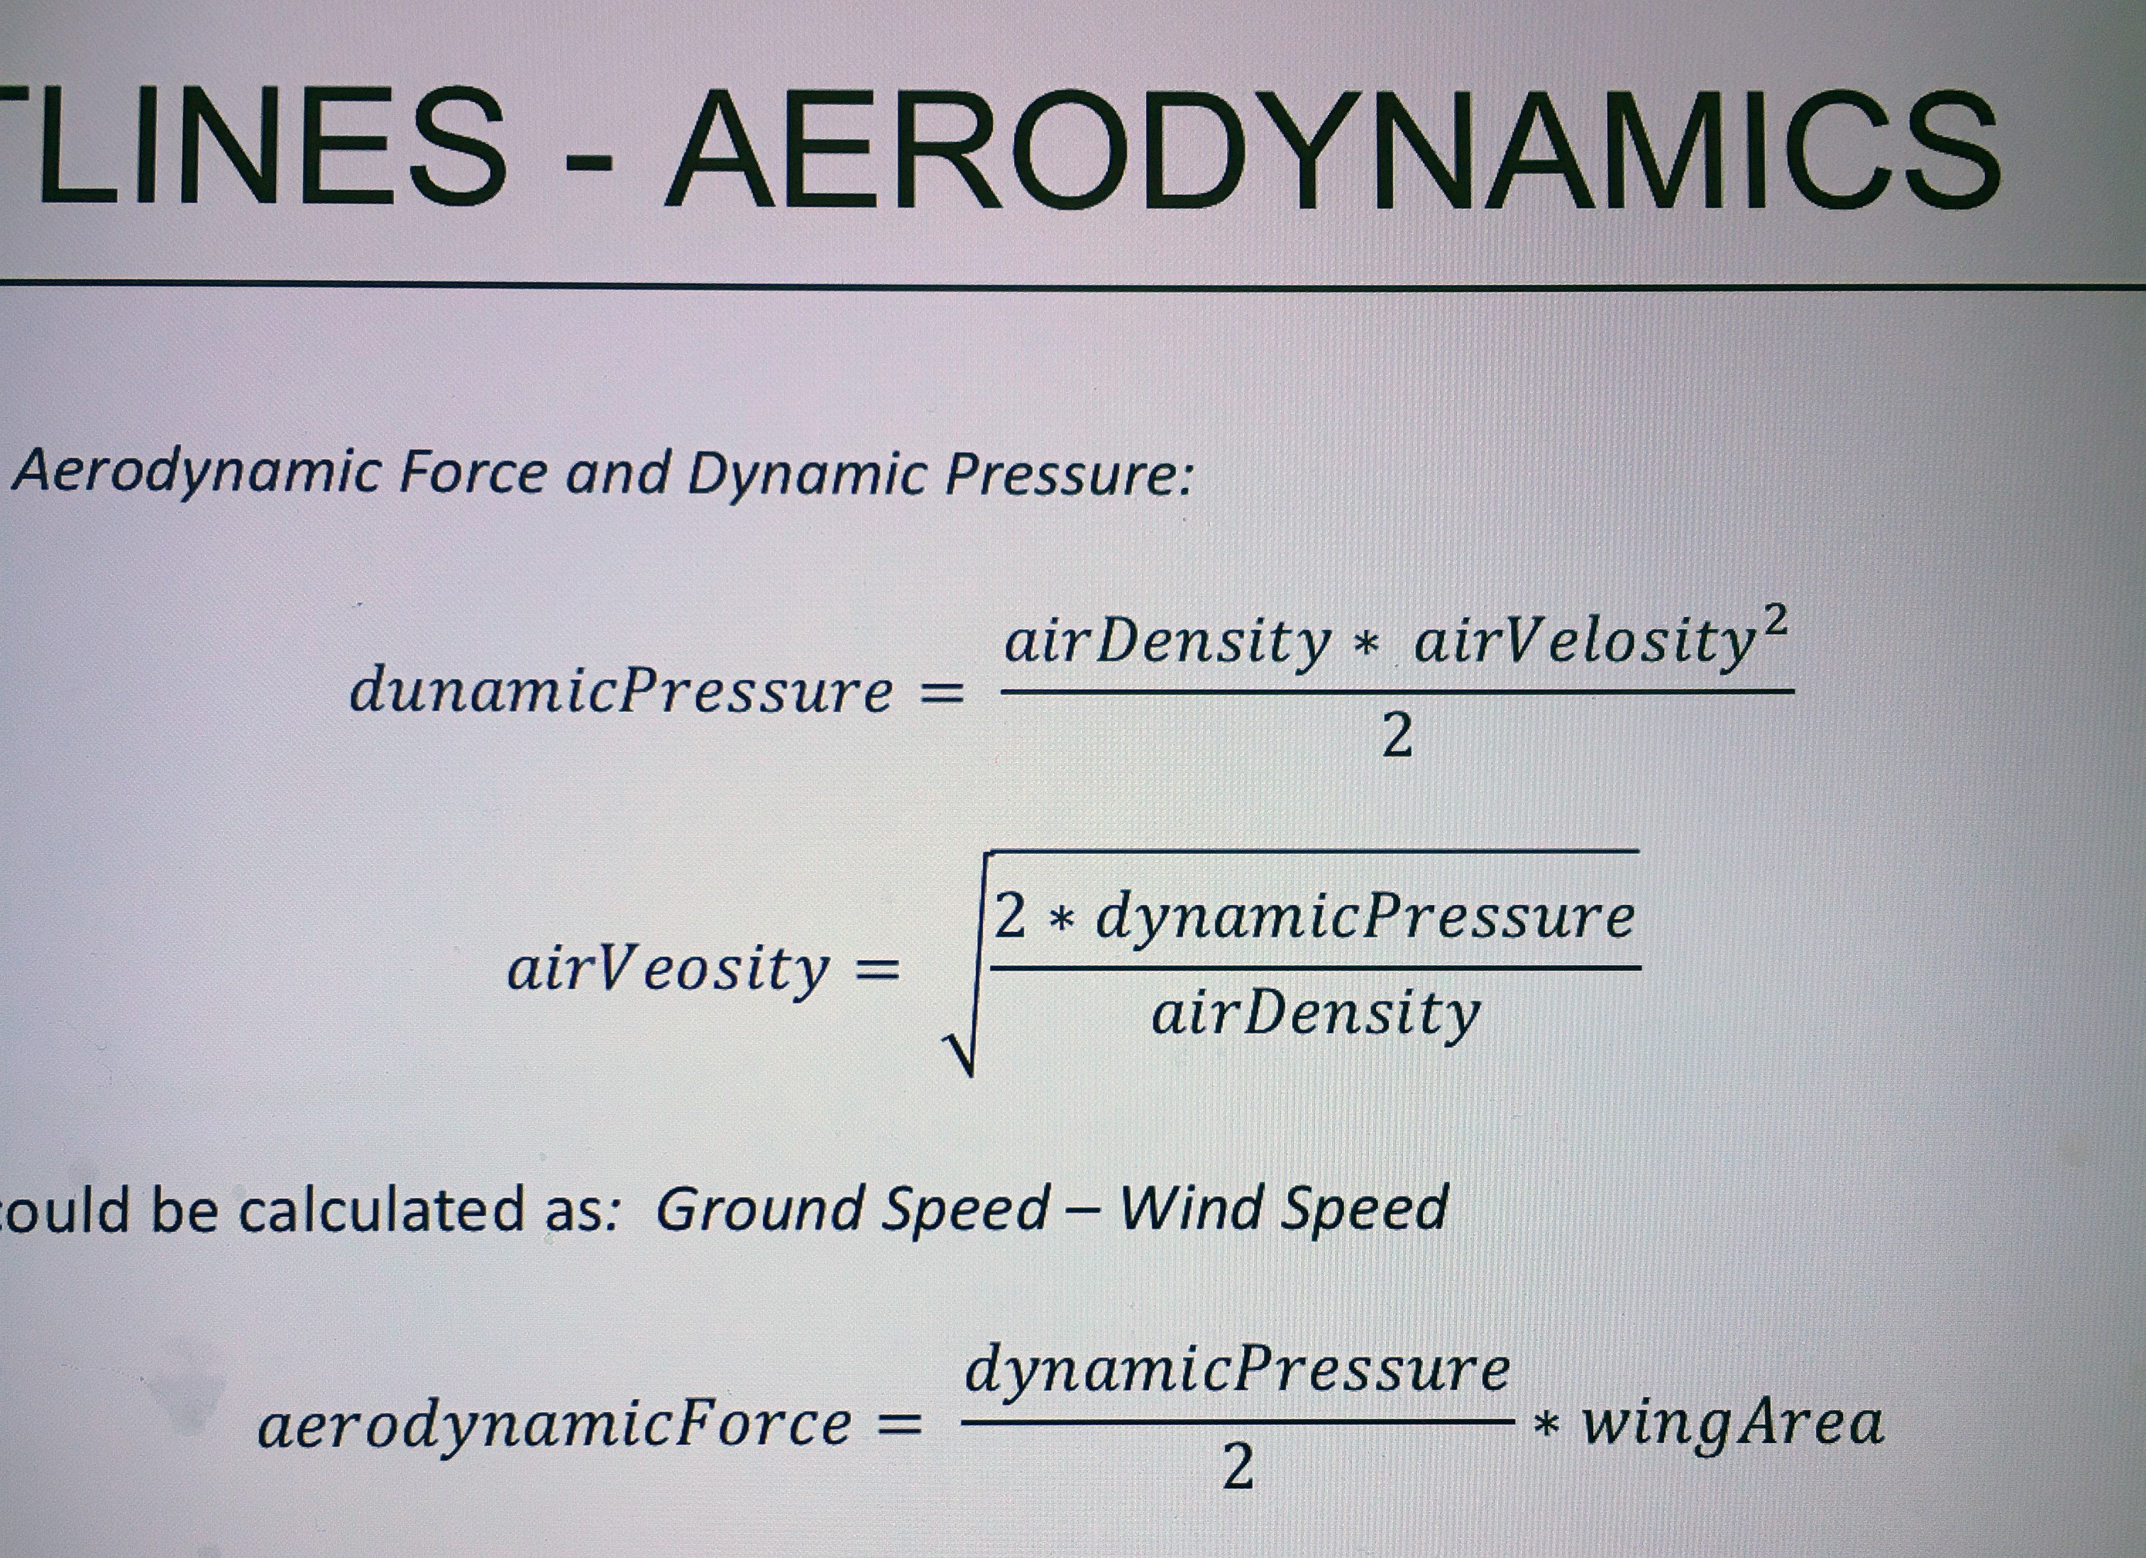
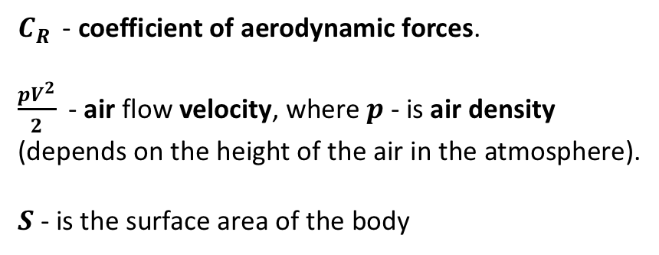
AERODYNAMICS
- coefficient of aerodynamic forces.
- air flow velocity, where - is air density
(depends on the height of the air in the atmosphere).
- is the surface area of the body

Slide 19

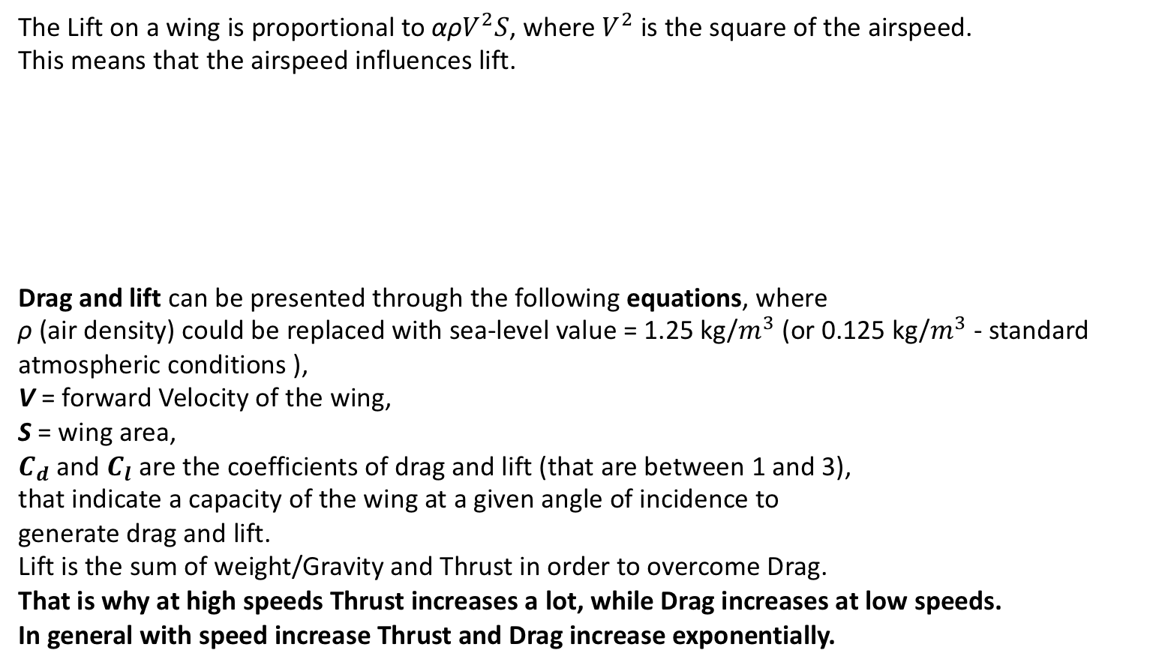
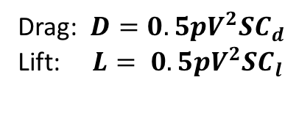
AERODYNAMICS
The Lift on a wing is proportional to αρ, where is the square of the airspeed.
This means that the airspeed influences lift.
Drag and lift can be presented through the following equations, where
ρ (air density) could be replaced with sea-level value = 1.25 kg/ (or 0.125 kg/ - standard atmospheric conditions ),
V = forward Velocity of the wing,
S = wing area,
and are the coefficients of drag and lift (that are between 1 and 3),
that indicate a capacity of the wing at a given angle of incidence to
generate drag and lift.
Lift is the sum of weight/Gravity and Thrust in order to overcome Drag.
That is why at high speeds Thrust increases a lot, while Drag increases at low speeds.
In general with speed increase Thrust and Drag increase exponentially.
Drag:
Lift:

Slide 20

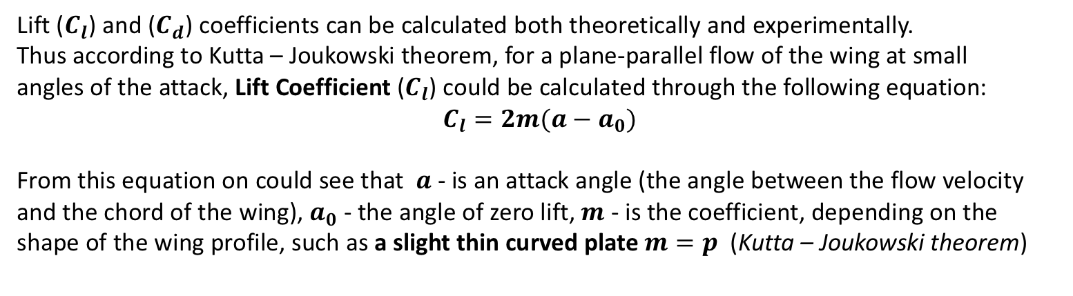
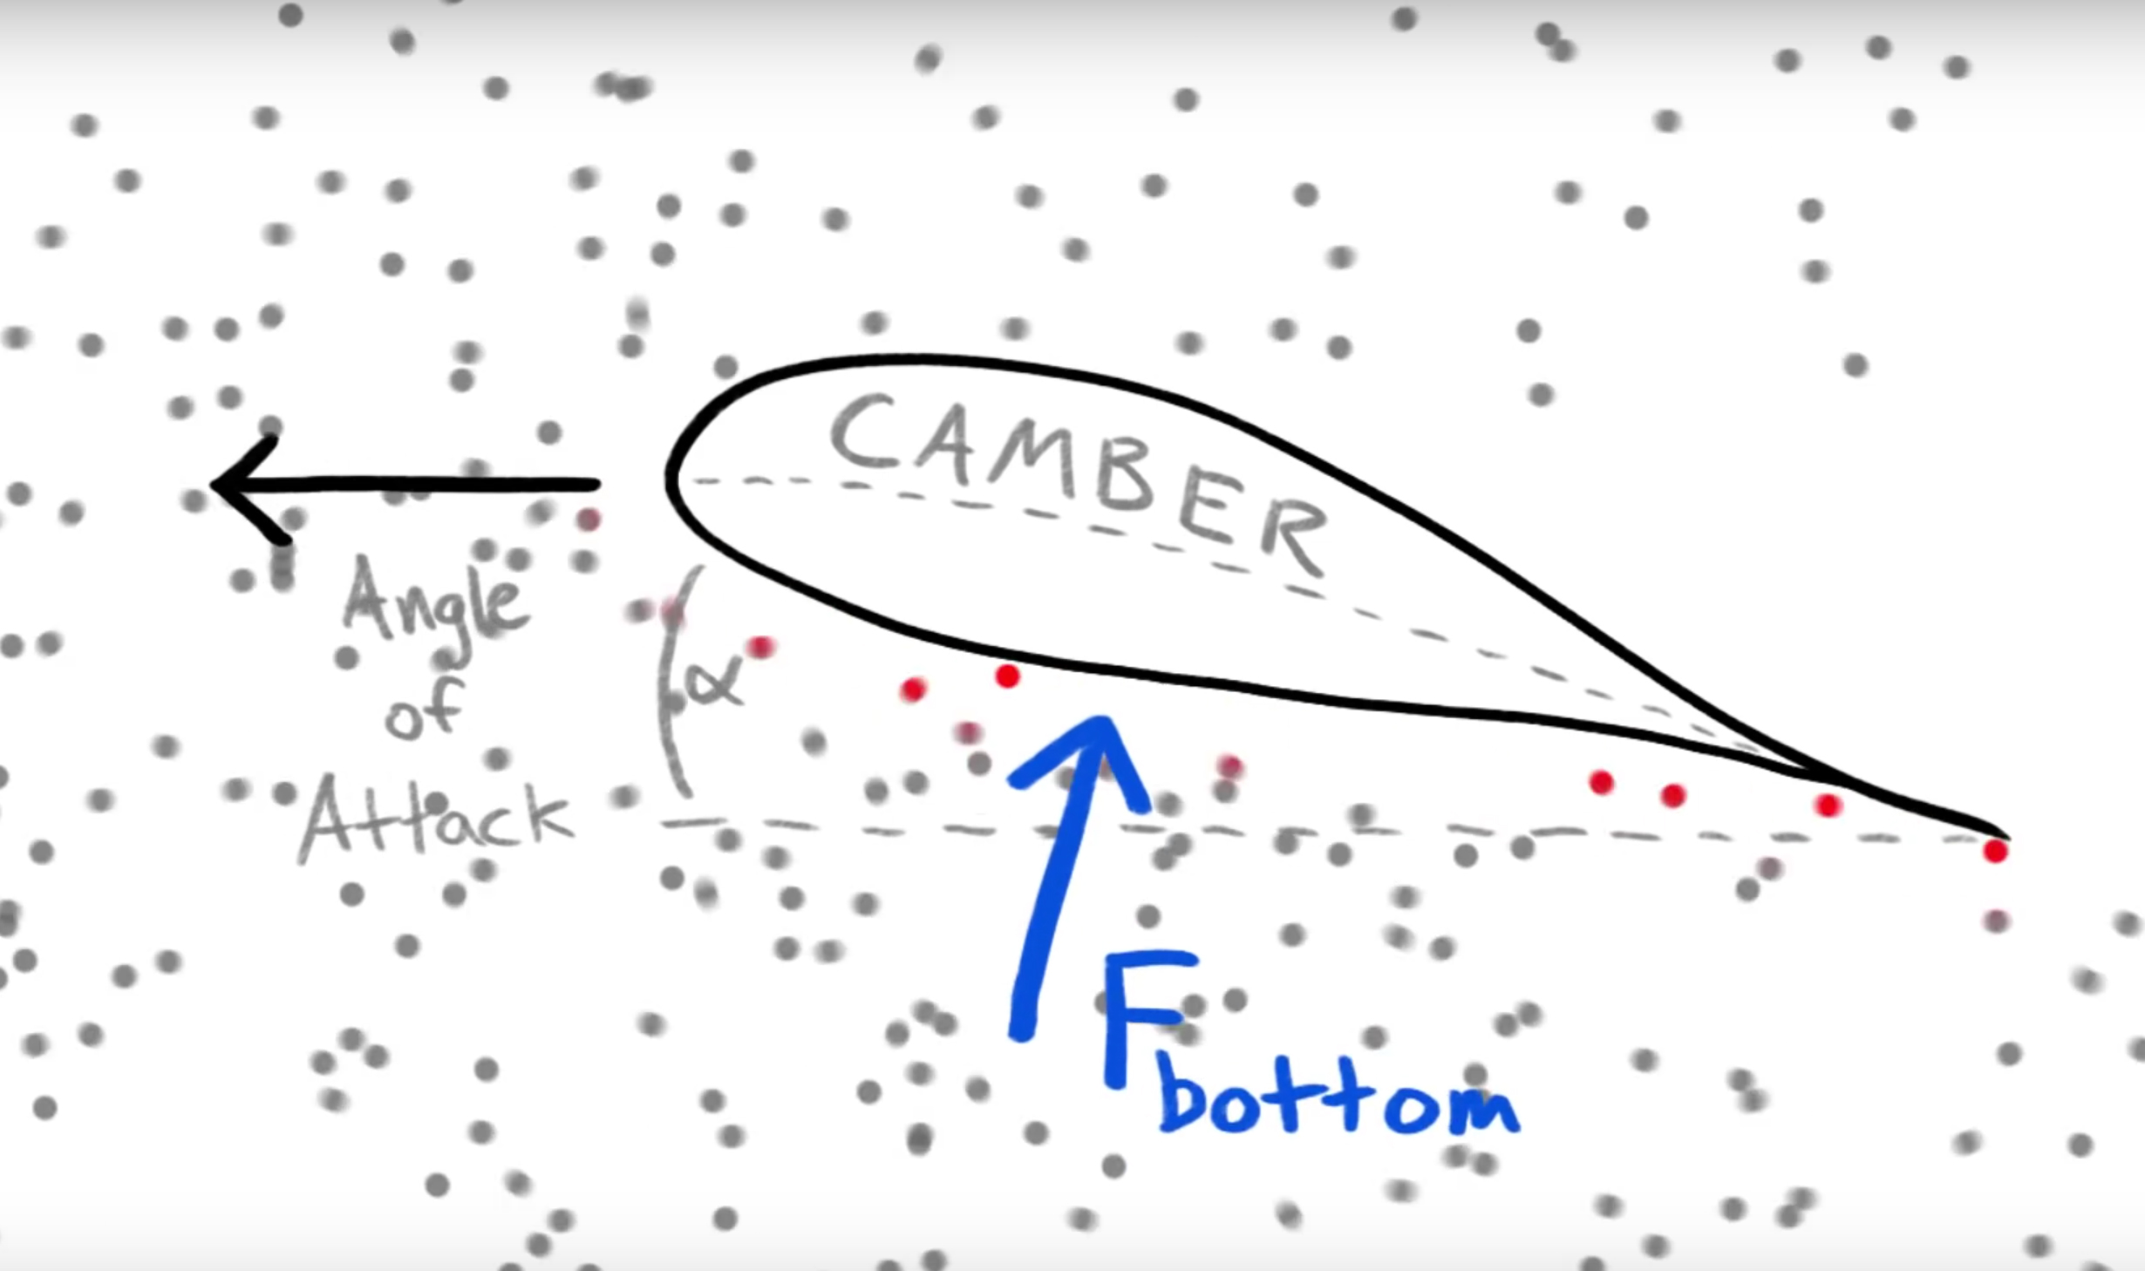
AERODYNAMICS
Lift () and () coefficients can be calculated both theoretically and experimentally.
Thus according to Kutta – Joukowski theorem, for a plane-parallel flow of the wing at small
angles of the attack, Lift Coefficient () could be calculated through the following equation:
From this equation on could see that - is an attack angle (the angle between the flow velocity
and the chord of the wing), - the angle of zero lift, - is the coefficient, depending on the
shape of the wing profile, such as a slight thin curved plate (Kutta – Joukowski theorem)

Slide 21
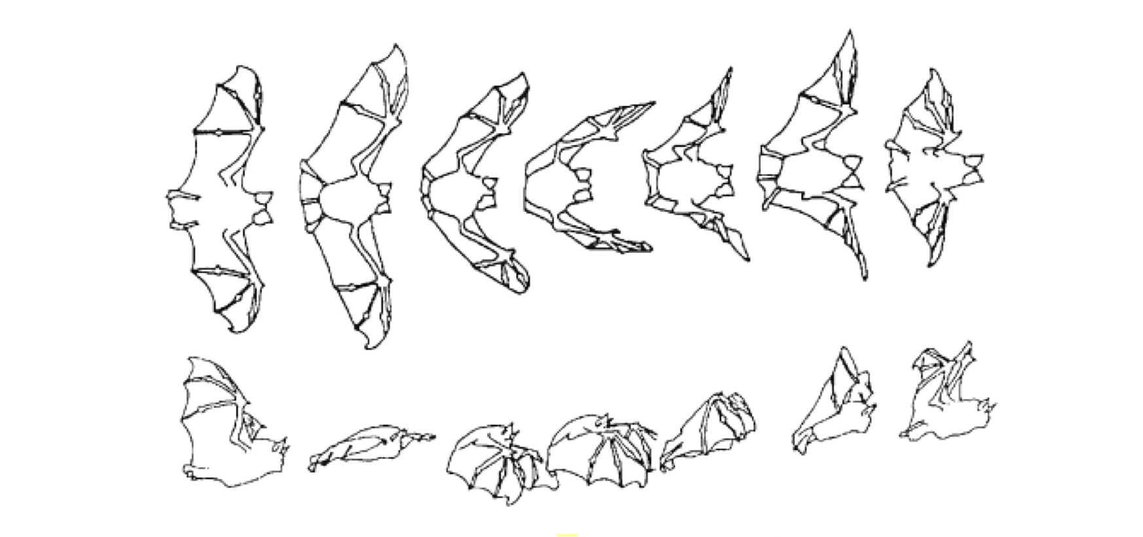
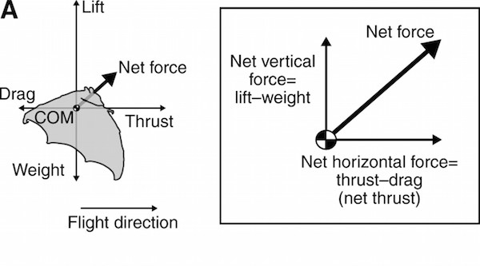
BATS´ FLYING GATE
Locomotor kinetics (vertical lift to overcome gravity and thrust to overcome drag) and kinematics
should be to considered together with wing size and shape (bat´s wing is ideal aerofoil), air density
and angle of the attack (α). α controls the lift.
Flight locomotion is divided into upstroke and downstroke, which produced one wingbeat cycle.

Slide 22
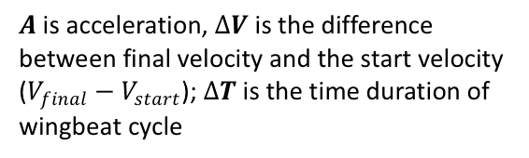
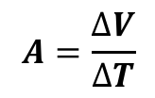
BATS´ FLYING GATE
Downstroke (when the wing goes down it opens in the joint similar to an umbrella principle and creates the following )
- wing surface become bigger,
- drag increases,
- thrust decreases,
at low speed = 50°;
α at high speed = 10° (in both cases lift is preserved).
A highly streamlined wing would have a high lift coefficient and low drag coefficient
Upstroke (when the wing goes up, it bents at the joint )
- wing surface become smaller,
- lift increases,
- thrust increases,
- drag decreases,
at low speed = -70°;
α at high speed = -10° (in both cases lift is preserved).
A less streamlined wing would have a lower lift coefficient and higher drag coefficient
With increase of flight velocity there is also
Decrease of maximum wingspan,
Increased wingbeat period (the time to complete wingbeat cycle),
Decrease angle of the attack
Decrease lift coefficient
is acceleration, is the difference
between final velocity and the start velocity
(); is the time duration of
wingbeat cycle
$A=\frac{∆V}{∆T}$

Slide 23
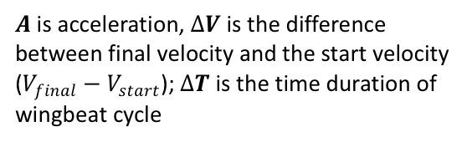
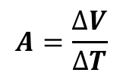
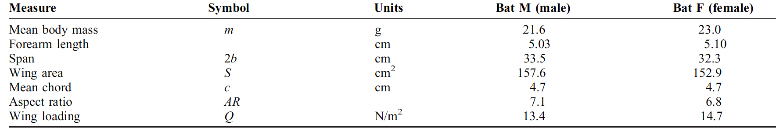
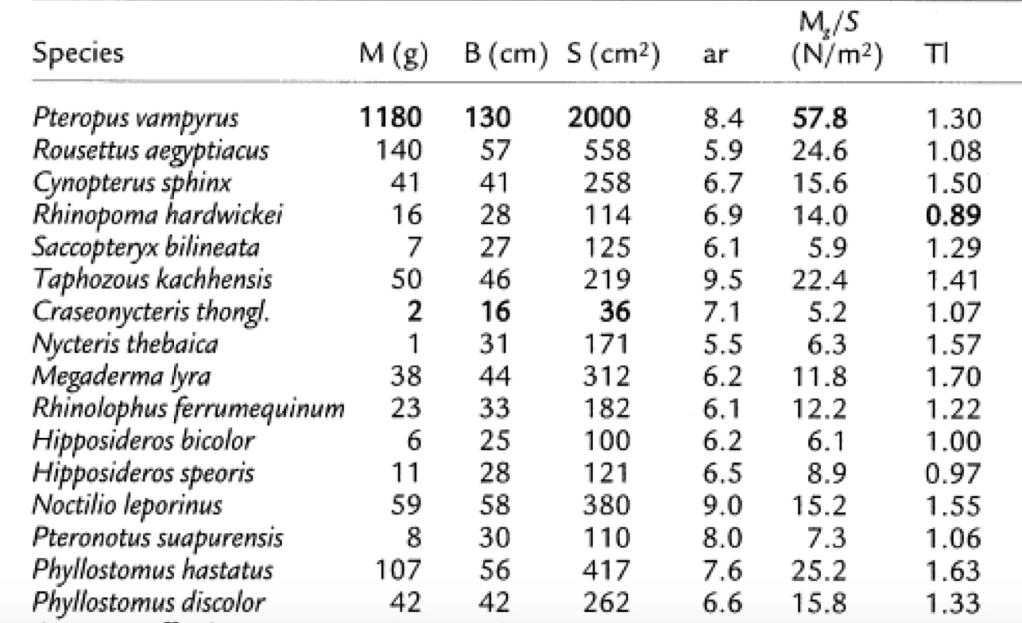
BATS´ FLYING GATE
With increase of flight velocity there is also
Decrease of maximum wingspan,
Increased wingbeat period (the time to complete wingbeat cycle),
Decrease angle of the attack
Decrease lift coefficient
is acceleration, is the difference
between final velocity and the start velocity
(); is the time duration of
wingbeat cycle
$A=\frac{∆V}{∆T}$

Slide 24
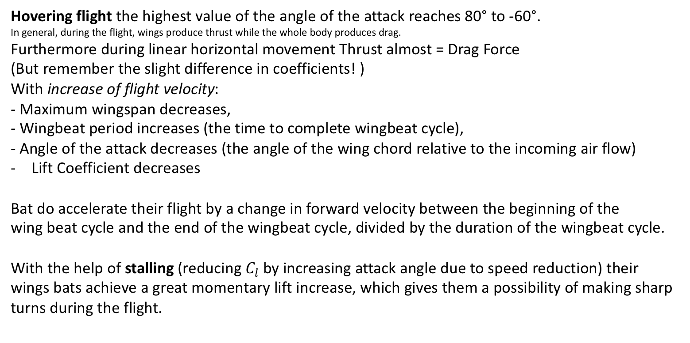
BATS´ FLYING GATE
Hovering flight the highest value of the angle of the attack reaches 80° to -60°.
In general, during the flight, wings produce thrust while the whole body produces drag.
Furthermore during linear horizontal movement Thrust almost = Drag Force
(But remember the slight difference in coefficients! )
With increase of flight velocity:
- Maximum wingspan decreases,
- Wingbeat period increases (the time to complete wingbeat cycle),
- Angle of the attack decreases (the angle of the wing chord relative to the incoming air flow)
Lift Coefficient decreases
Bat do accelerate their flight by a change in forward velocity between the beginning of the
wing beat cycle and the end of the wingbeat cycle, divided by the duration of the wingbeat cycle.
With the help of stalling (reducing by increasing attack angle due to speed reduction) their
wings bats achieve a great momentary lift increase, which gives them a possibility of making sharp
turns during the flight.

Slide 25
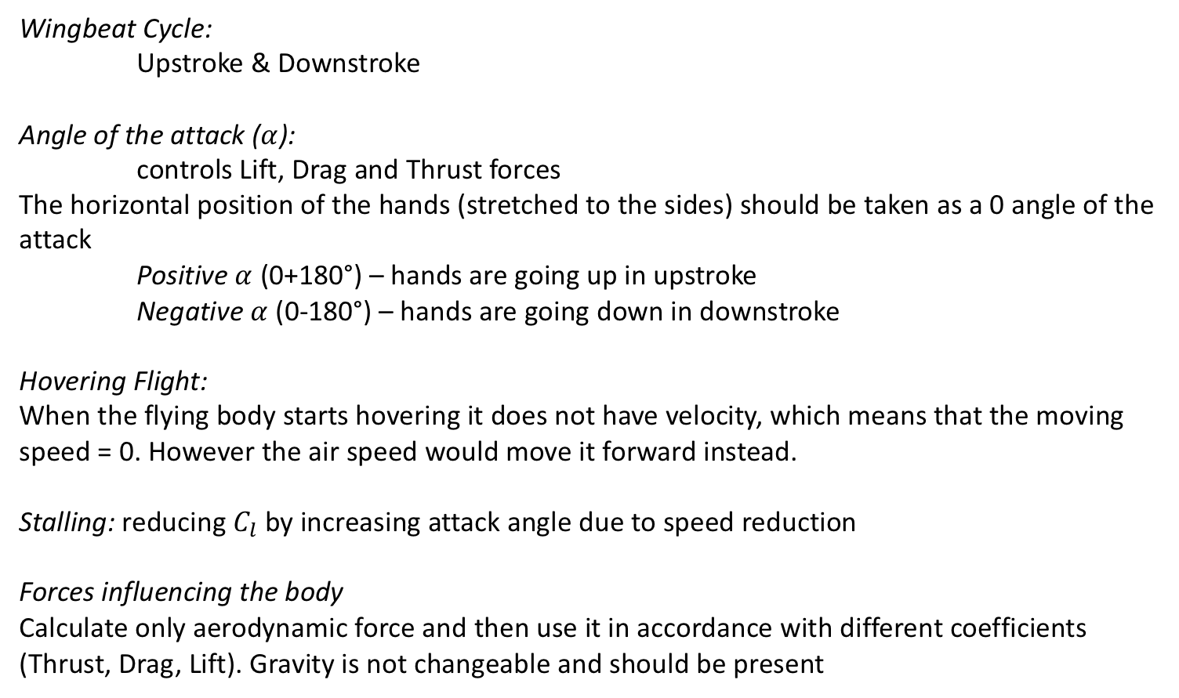
OUTLINES - BIOLOGY
Wingbeat Cycle:
Upstroke & Downstroke
Angle of the attack ():
controls Lift, Drag and Thrust forces
The horizontal position of the hands (stretched to the sides) should be taken as a 0 angle of the attack
Positive (0+180°) – hands are going up in upstroke
Negative (0-180°) – hands are going down in downstroke
Hovering Flight:
When the flying body starts hovering it does not have velocity, which means that the moving speed = 0. However the air speed would move it forward instead.
Stalling: reducing by increasing attack angle due to speed reduction
Forces influencing the body
Calculate only aerodynamic force and then use it in accordance with different coefficients (Thrust, Drag, Lift). Gravity is not changeable and should be present

Slide 26
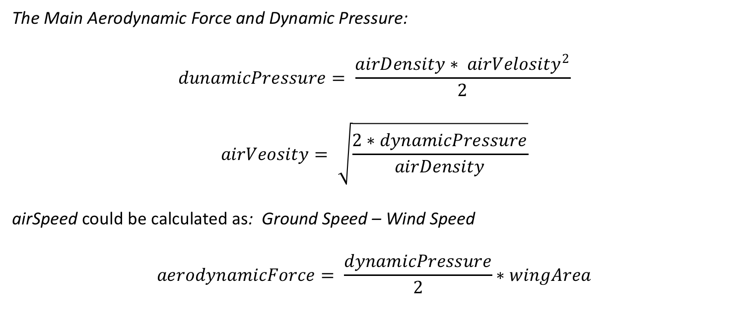
OUTLINES - AERODYNAMICS
The Main Aerodynamic Force and Dynamic Pressure:
airSpeed could be calculated as: Ground Speed – Wind Speed
You have got all data in the tables/figures in the previous slides

Slide 27
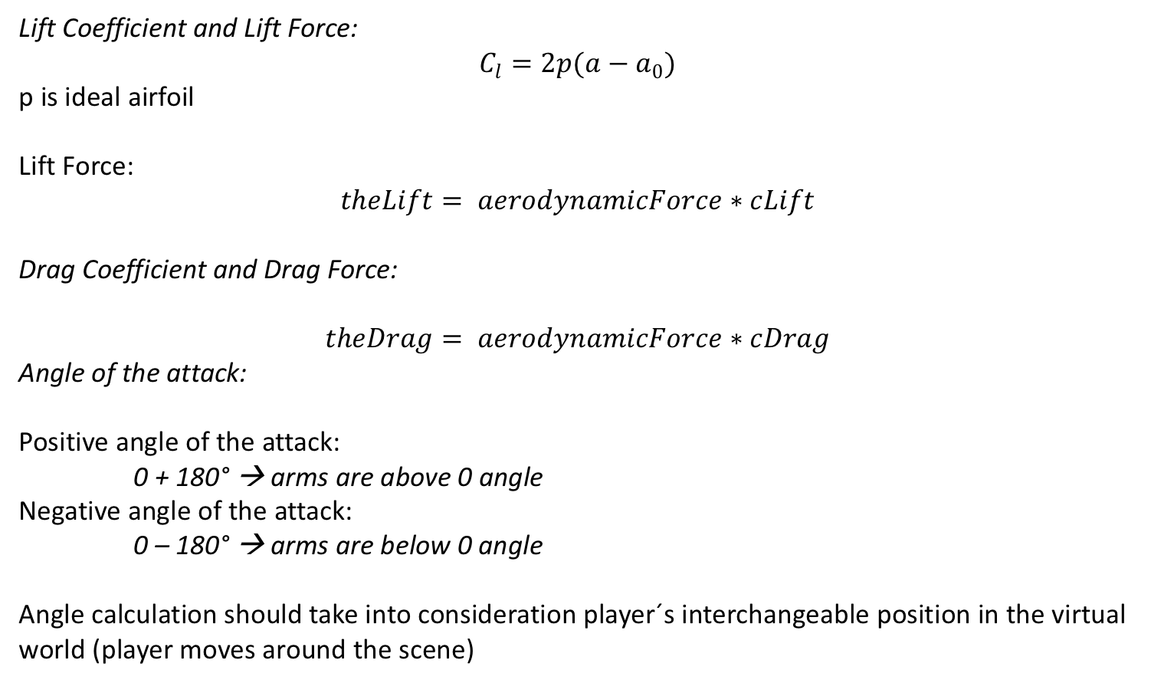
OUTLINES - AERODYNAMICS
Lift Coefficient and Lift Force:
p is ideal airfoil
Lift Force:
Drag Coefficient and Drag Force:
Angle of the attack:
Positive angle of the attack:
0 + 180° → arms are above 0 angle
Negative angle of the attack:
0 – 180° → arms are below 0 angle
Angle calculation should take into consideration player´s interchangeable position in the virtual world (player moves around the scene)

Slide 28
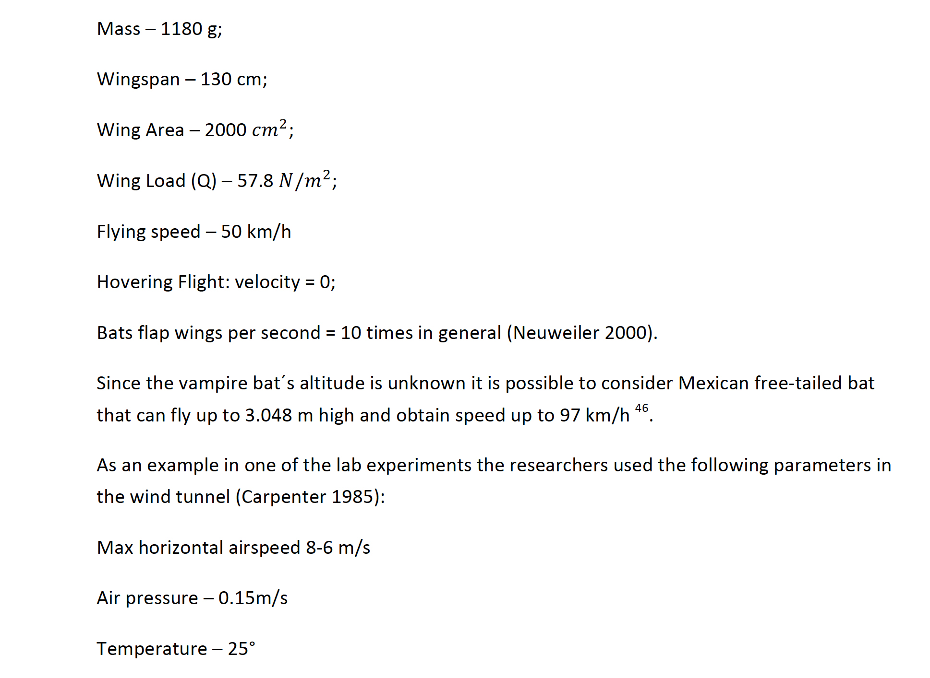
OUTLINES - BIOLOGY

Slide 29

EXERCISE – 1.1
In Unity:
1. Create 2 virtual trackables (2 objects) and make controls for them (so that they are able to move on the scene either with buttons or mouse)
2. In a T-pose make a calibration: if hands/trackables are stretched to the sides their angle = zero. Calibration should take 5 seconds
3. Calculate angle (without using inbuilt Unity angle function)
a) if hands/trackables move up, the angle should be positive (calculated from zero angle)
b) if hands/trackables move down the angle should be negative (calculated from zero angle)
When delivering export the package from Unity and upload it
Remember to comment!
In each line - explain in the comments what have you done and why.
Should you consider world or local coordinates when calculating the angle?

Slide 30
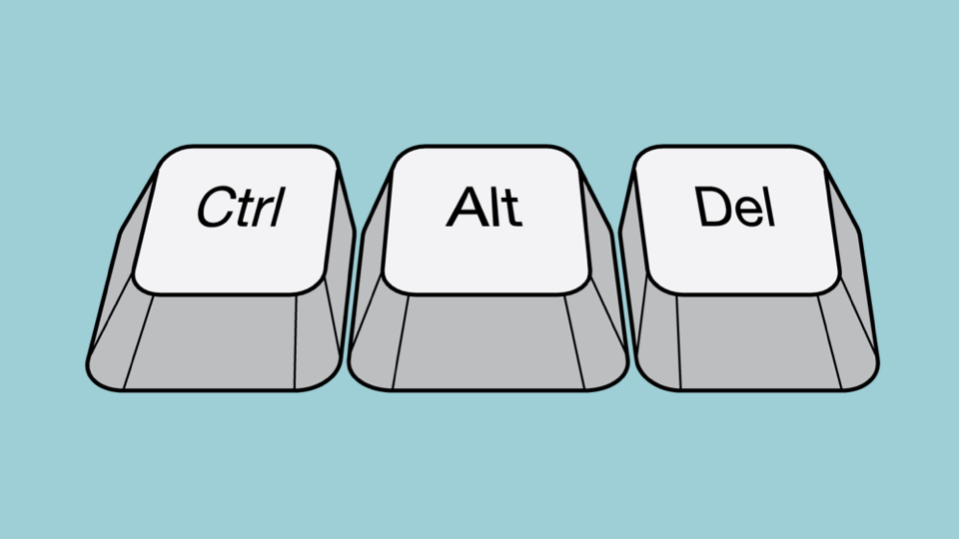
BREAK !

Slide 31
EXERCISE – 1.2
Create a User-Case Diagram
for the flight, taking into
consideration input gestures
As a suggestion: Nclass or Violet:
http://alexdp.free.fr/violetumleditor/page.php

Slide 32
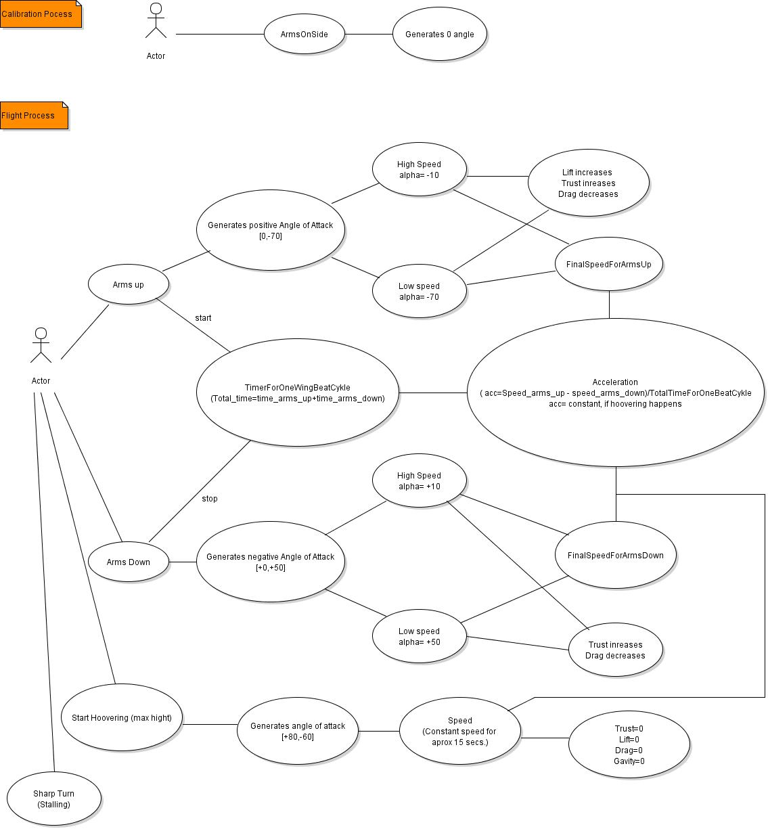
EXERCISE – 1.2 - Example

Slide 33
EXERCISE – 1.3
Create a Class-Diagram out of the User-Case Diagram
As a suggestion for Class-Diagram:
http://nclass.sourceforge.net/
http://people.cs.ksu.edu/~schmidt/501s13/Lectures/VSnotesS.html#0.1

Slide 34
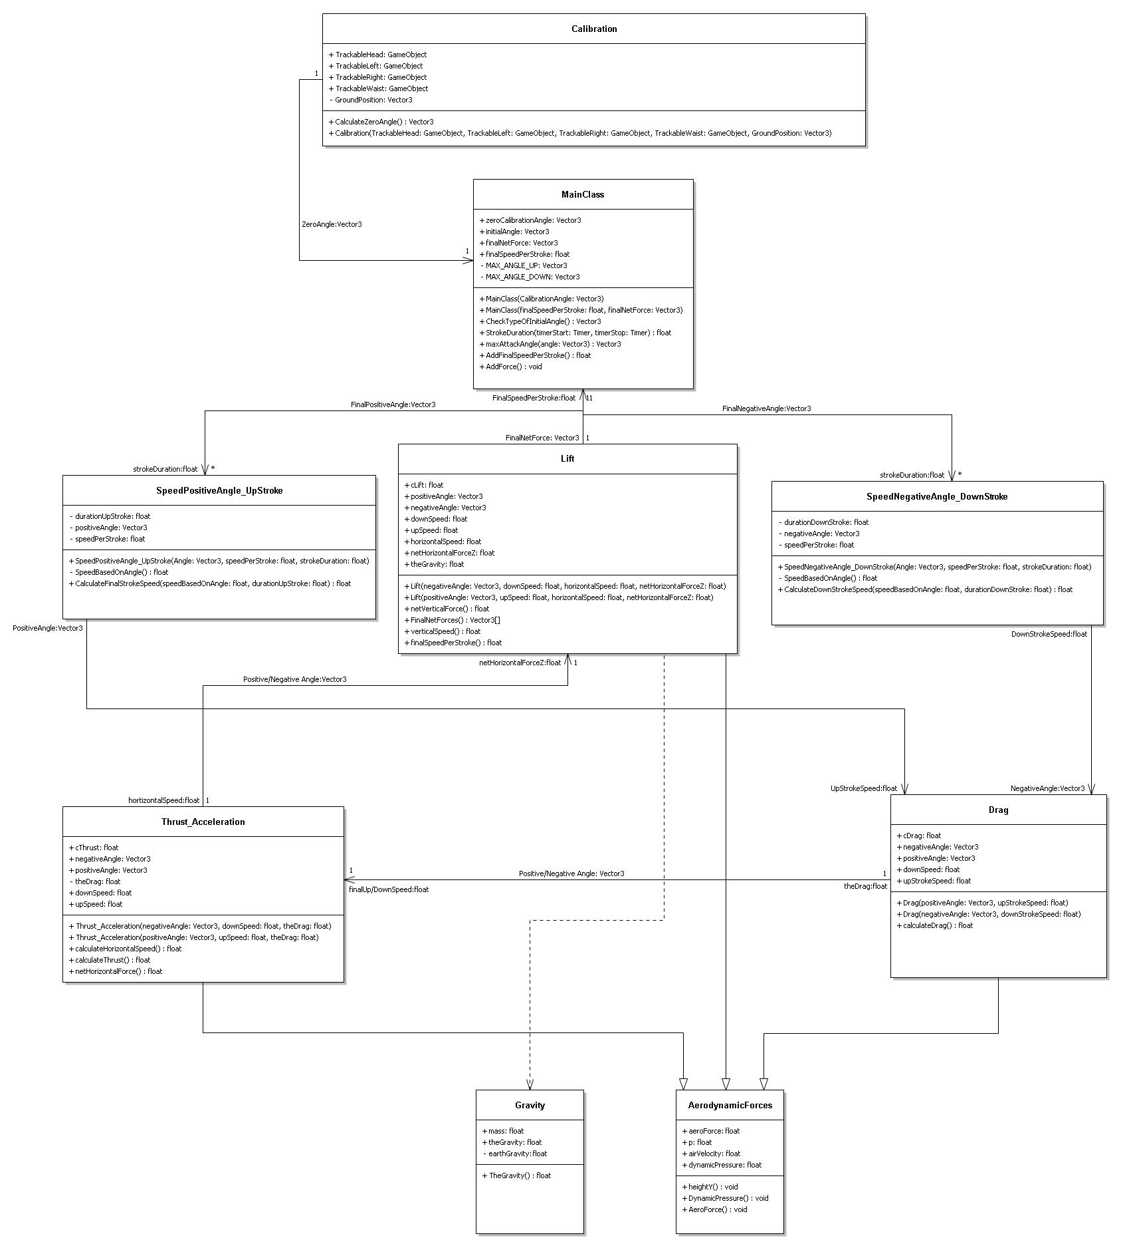
EXERCISE – 1.3 - Example

Slide 35
EXERCISE – 1.4
Split your working load and start programming the flight
Inspiration:
https://www.recreationalflying.com/tutorials/groundschool/index.html
https://www.grc.nasa.gov/www/k-12/airplane/forces.html
https://www.grc.nasa.gov/www/k-12/VirtualAero/BottleRocket/airplane/forces.html
https://www.grc.nasa.gov/www/k-12/UEET/StudentSite/dynamicsofflight.html
http://jeb.biologists.org/content/218/5/653
http://heli-air.net/2016/02/08/the-ideal-aerofoil/

Slide 36

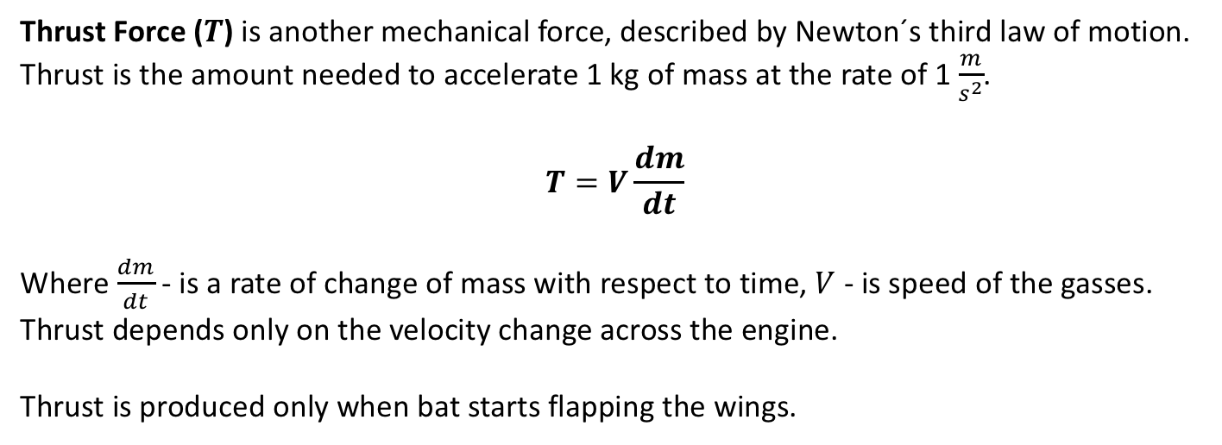
AERODYNAMICS
Thrust Force () is another mechanical force, described by Newton´s third law of motion.
Thrust is the amount needed to accelerate 1 kg of mass at the rate of 1 .
Where - is a rate of change of mass with respect to time, - is speed of the gasses.
Thrust depends only on the velocity change across the engine.
Thrust is produced only when bat starts flapping the wings.

Slide 37
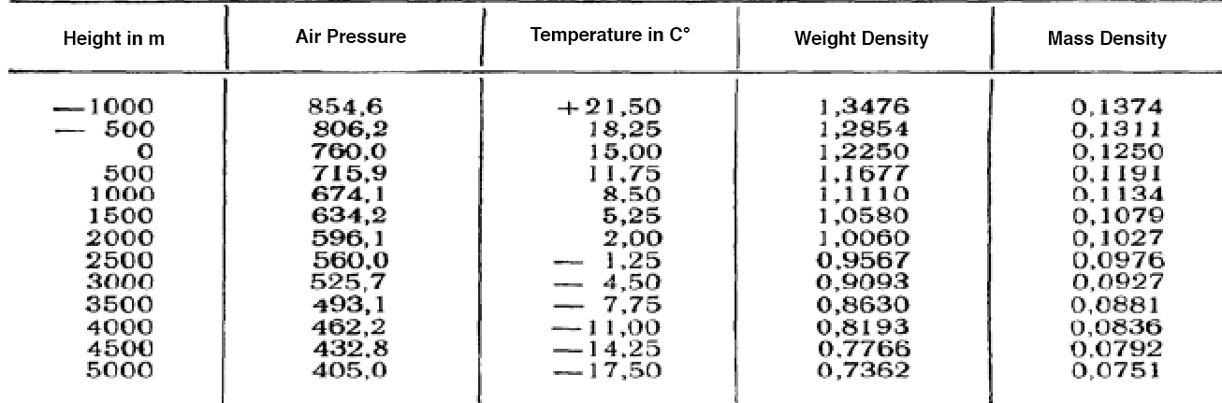
AERODYNAMICS
Includes several general laws of motion of the gas (mostly air) as well as interaction between
gas and moving bodies in this medium
the main parameters, characterizing air :
Temperature,
Density,
Pressure.
The standard or normal atmosphere for a 0 level is considered to be a mean of a sea level.
If Gravity is neglected it could be assumed that air movement occurs in a horizontal plane,
which means that potential energy of air mass does not change

Slide 38

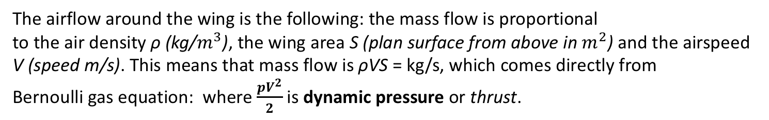
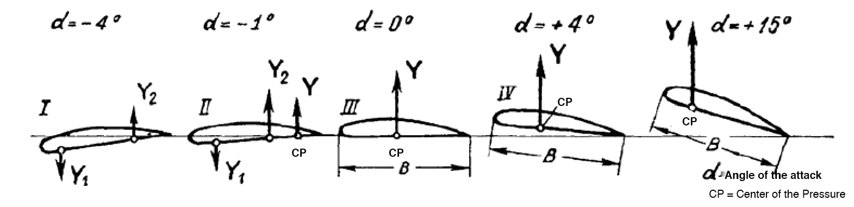
AERODYNAMICS
The airflow around the wing is the following: the mass flow is proportional
to the air density ρ (kg/), the wing area S (plan surface from above in ) and the airspeed
V (speed m/s). This means that mass flow is ρVS = kg/s, which comes directly from
Bernoulli gas equation: where is dynamic pressure or thrust.
Airspeed leaving the bottom of the wing is proportional to the flight speed V and
the angle of attack of the wing α
critical angle of the attack of the wings = 15°, the airflow on the top surface is disrupted,
which means that the lift decreases and is not proportional anymore to the angle of the attack.
At the same time drag increases and the bird can go down like a brick

